Slide 1
CREATION OF A WEBSITE
Name of the enterprise: Global Auto- ecole
Name of the project: creation of a website for Global Auto-ecole
Some one to contact in the enterprise: Mr Mezang Andre
Tel: 655 93 19 36/674 78 79 941
PRESENTATION OF THE ENTERPRISE
Date of Creation:2008
Main activity: Acquire a professional driving license both international and national
Main competitors: for example( Auto-ecole Kassap, Auto ecole Bercy)
Analysis of the existing
Programming language: JavaScript, HTML, CSS, python…
Type of language used: English Language.
Accommodation uses: Host stinger
Actual statistics: No site yet
The type of site: Enterprise
Location of the enterprise: Melen face Fokou, Douala Ndogbong face SCB Bank, Bafoussam face stade Omnisport
The number of people involve in the creation of the website: 2 people
CAHIER DE CHARGE

Slide 2
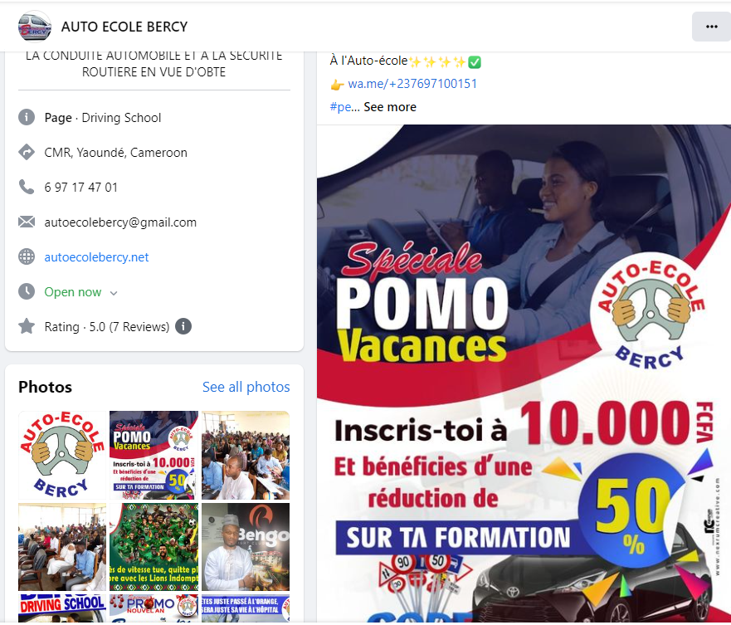

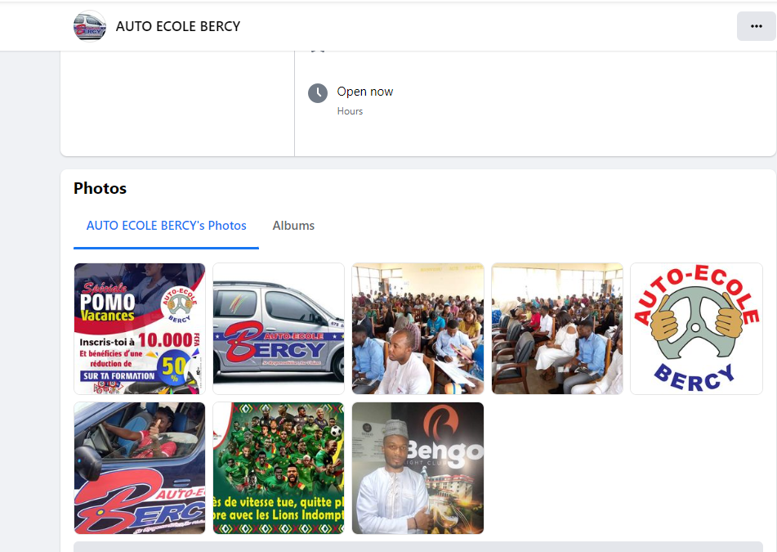
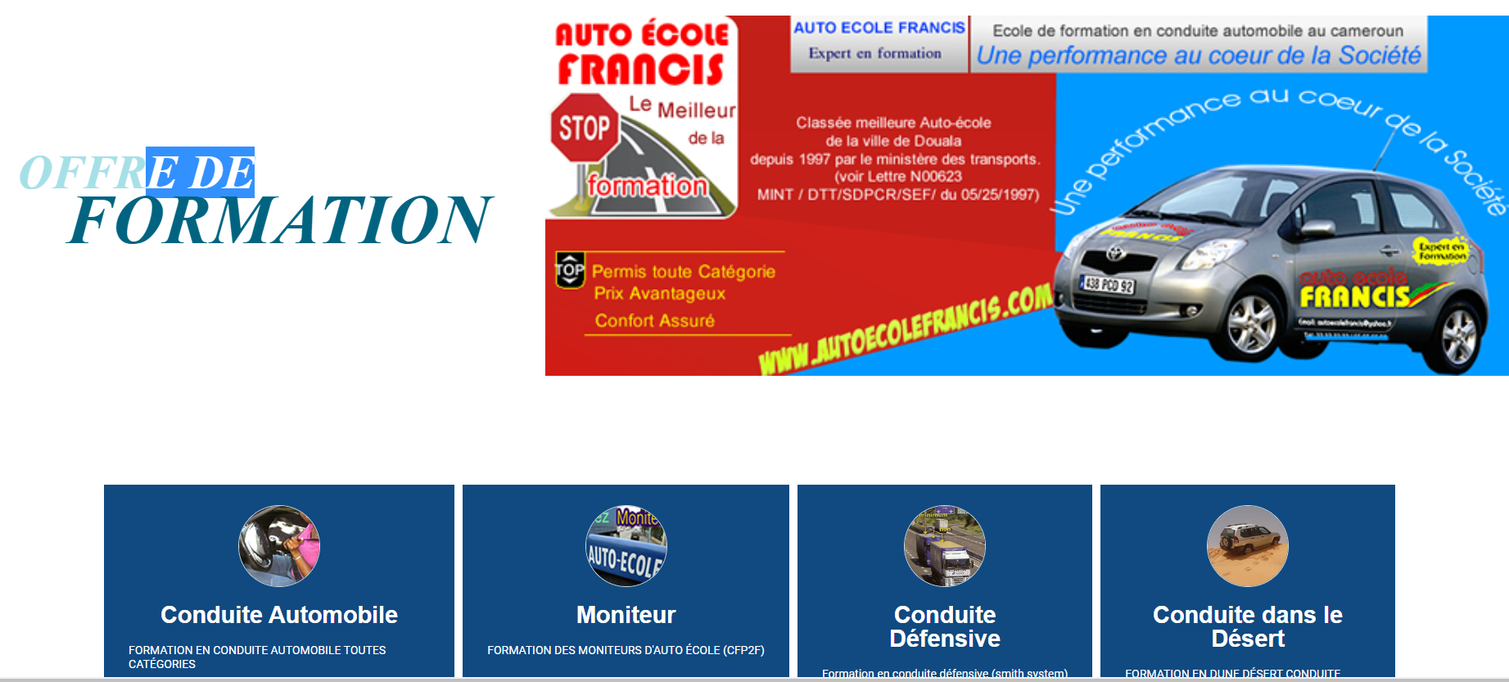
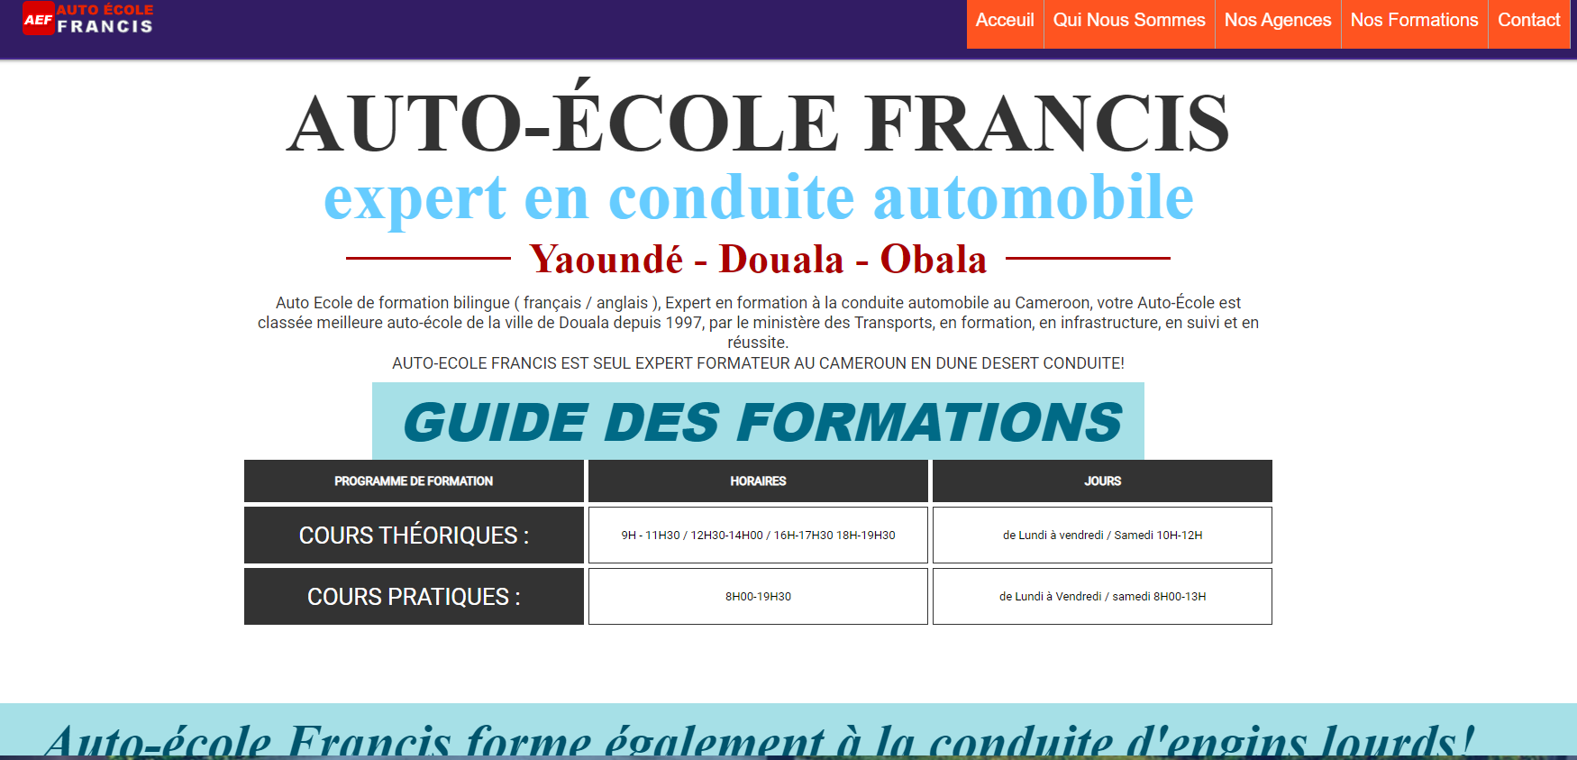
Examples of other sites

Slide 3
OBJECTIVE OF THE WEBSITE
Let people find you
Having a website makes you available. Once you become available you become available there is no stopping you from wat you can do. We need to show them what we can do
Higher customer satisfaction
Supporting you existing and potential customers is an obvious goal for the website. Better user experience and service can go a long way to establish and maintain the customer relationship.
Choose a good domain name
This will be the website address where people find you. It helps if you have during in the URL- do, it make people guess what you do when they see you website address written. Have a look at what your competitors are doing. For example(www.global auto-ecole.com)
.COM(Starting from$9.99)
.net(starting from$12.99)
.org(starting from$8.99)
.tech(starting from ($4.99)
Choose the right technology
We will need to choose a content management system(CMS) that allows us to make changes to the website. Examples include;
WordPress
Visual studio code
Weebly
Plan it out
Look at what your competitors are doing, then make the site more better. Plan out how people will interact will your website and what you will say on it.
Choose a good template
It saves time to start with a template in mind. You can use a website like TemplateMonstaer or Themeforest. The web designer will be able to modify the theme to suite you. Keep the design simple and use colors that complement your logo and branding.

Slide 4
Mobile first
Over half of the traffic is on the mobile phone, so we need to ensure that the website is “responsive”. This means that the design should adapt to work on a mobile phone, tablet or computer.
Characteristics of what the site should look like
Clearly display prices
One of the most important things visitors to the driving school website will want to do is compare your prices against other driving schools. We recommend that you outline exactly how the cost is broken down across all the options that you offer.
Provide information about you(or your team of instructors)as individuals
Give a much detail about yourself as possible, including qualifications. If Your prices are not the cheapest ,explain why.
Easy to find contact and booking information
While this is an important part of any driving school website, providing contact information is absolutely vital in your case. It is also a good idea to implement an easy-to use online booking form on your website
Contain a detailed list of services
The website should contain an easy to read list of all types of courses that you offer with detailed information about each, as well as who the course is aimed at.
Graphic
Purpose
Visual/Aesthetic appeal
Create visual structure
Communicate ideas visually
Graphic Formats used
JPEG
PNG

Slide 5
Technical constraints
Budget
In the design, we should think about the budget allowed for the project and consider it when thinking about the sections which is not yet known.
Brand guidelines
Everything we include on the website must reflect and present the brand color, fonts, layout and the actual web copy used
Browser
The browser used will be Google
Calendar
Project timeline
The project timeline needs to be created in 2 months.
Graphics and Ergonomic
Number of pages the site should have
Home
About us page
Contact page
Pricing
Information
Reservation/Booking

Slide 6
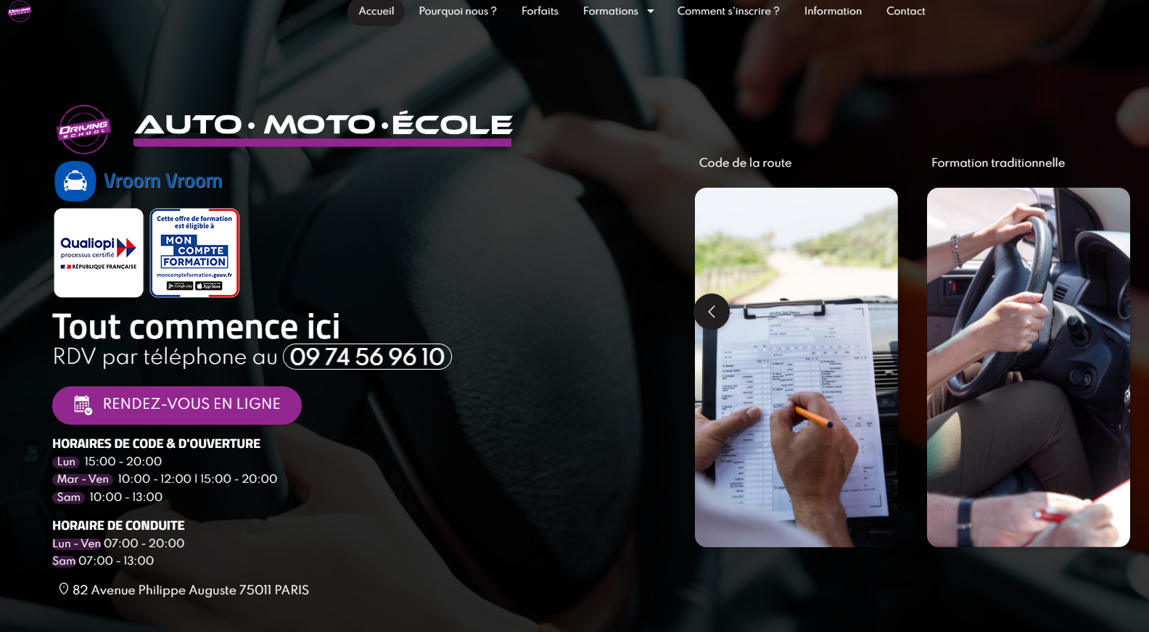

Slide 7
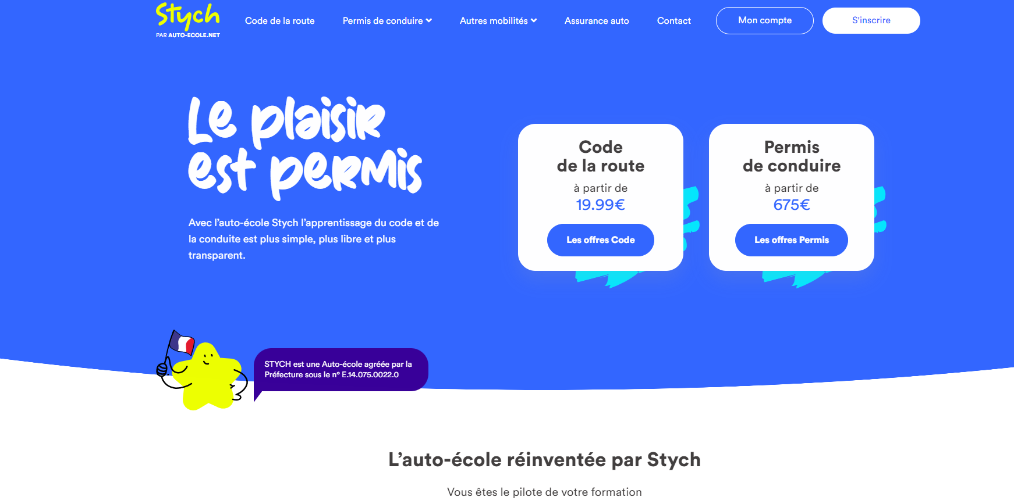

Slide 8
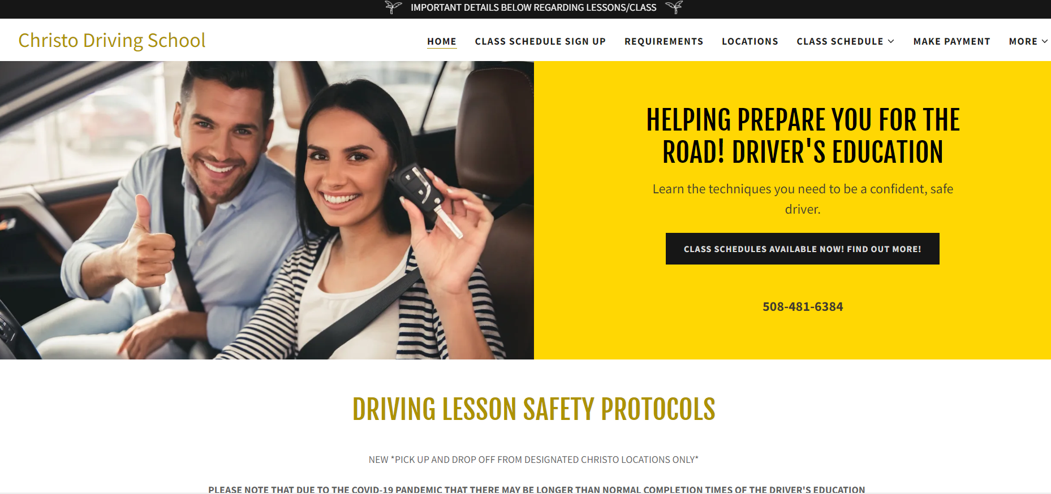

Slide 9
